Slide 1

Academic Orientation 2024
John H. Daniels Faculty of Architecture, Landscape, and Design

Slide 2
Welcome to Daniels!
Let’s get ready for your first year at the John H. Daniels Faculty of Architecture, Landscape, and Design!
The Office of the Registrar and Student Services (ORSS) is your first stop for any academic or personal matters.

Slide 3

The Basics
You are a now a Daniels student pursuing an Honours Bachelor of Arts.
As a Daniels student you will:
have an amazing team of faculty, staff, and peers ready to support, help, and guide you as you navigate your transition to university
enjoy partnerships with the Faculty of Arts & Science and have access to over 300+ programs of study!
occupy three Daniels buildings on the St. George campus
  Daniels Faculty at 1 Spadina Crescent
  North and South Borden Buildings at 563 and 487 Spadina Crescent

Slide 4
1 Spadina Crescent

Slide 5
Getting Started
The New Undergraduate Student Handbook 2024-2025 is your guide to getting ready for your first-year at Daniels. To begin you should read the handbook (cover to cover) and complete the following:
  Get your student ID (TCard, UTORid and UTmail+ account)
  Review the Academic Calendar 2024-25 and Timetable on the Daniels website
  Familiarize yourself with all the services and resources available to you
  Follow us on social media
@uoftdaniels

Slide 6
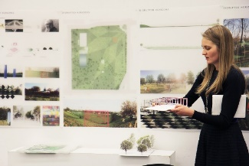
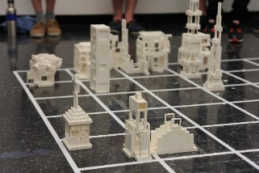
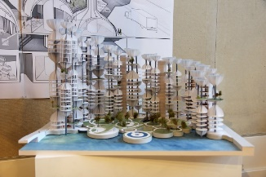
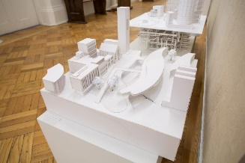


Architectural Studies
Architectural Studies begins with an introduction to the fundamentals of the field through design, history, and technology/computation.
This program initiates students into the discipline of architecture, using it as a unique lens through which to pursue a liberal arts education

Slide 7

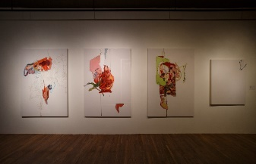
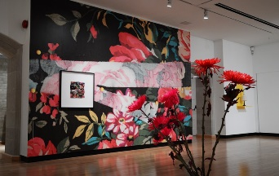


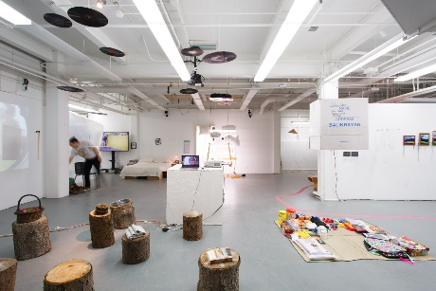
Visual Studies
Visual Studies is set within a unique environment focusing on the interdisciplinary and conceptual components inherent to contemporary art and curatorial practice, as well as on critical writing, theory, art history, design, and related areas requiring a high degree of visual literacy.

Slide 8
Degree Requirements
The Honours Bachelor of Arts degree requirements are found in the Academic Calendar and the New Undergraduate Student Handbook
To graduate a student must complete:
  A total of 20.0 Credits
  A minimum of 13.0 Credits at the 200 level, including a minimum of 6.0 Credits at the 300+ level
  1.85 Cumulative Grade Point Average (CGPA) for Graduation
  4.0 Credits satisfying Breadth Requirements
  An appropriate combination of programs of study
Degree Explorer is a tool found on ACORN that can help you monitor your progress towards both your degree and program of study requirements

Slide 9
Program of Study
Architectural Studies
Specialist in Architectural Studies
All students are automatically enrolled in the Comprehensive Specialist stream for their first year of study in the Daniels Faculty.
After your 2nd year of study, with the completion of the required 8.0 credits, you may wish to apply to one of the more directed streams:
  Design of Architecture, Landscape, and Urbanism;
  History and Theory of Architecture, Landscape, and Urbanism; or
  Technology of Architecture, Landscape, and Urbanism.
To be eligible to apply to one of the streams above, you meet the admission requirements listed in academic calendar. Meeting the admission requirements for these streams does not guarantee entry.
Information sessions are held every Winter Term to provide more information.

Slide 10
Program of Study
Visual Studies
1 Specialist in Visual Studies (Studio Stream or Critical Practices stream)
OR Major in Visual Studies + Major in Architectural Studies*
OR Major in Visual Studies + 1 Major, Faculty of Arts & Science*
OR Major in Visual Studies + 2 Minors, Faculty of Arts & Science*
*These combinations must include at least 12.0 different Credits.
All Visual Studies students are automatically enrolled in the Major in Visual Studies

Slide 11
Course Load
A typical course load is 5.0 credits per academic year
Most Daniels courses count as 0.5 credit which means you may take between 3 - 5 courses per term
Architectural Studies
Fall Term: 2.5 credits total
JAV120H1F
JAV151H1F
ARC100H1F
ARC180H1F
Elective H1F
Visual Studies
Fall Term: 2.5 credits total
JAV120H1F
JAV130H1F
JAV151H1F
FAH101H1F
Elective H1F

Slide 12
Course Selection
What courses do I have to take in my first year?
First-year student in the Architectural Studies Comprehensive Specialist Stream, have eight required courses (4.0 Credits):
JAV120H1 F Visual Concepts
JAV151H1 F History of Architecture, Landscape, Urbanism, and Art I
ARC100H1 F Drawing and Representation I
ARC180H1 F Computation and Design
JAV101H1 S Design Studio I
JAV130H1 S Visual Strategies
JAV152H1 S History of Architecture, Landscape, Urbanism, and Art II
ARC181H1 S Technologies of Architecture, Landscape, Urbanism, and Art I

Slide 13
Course Selection
What courses do I have to take in my first year?
First-year student in the Visual Studies Major Stream, you have six required courses (3.0 Credits):
JAV120H1 F Visual Concepts
JAV130H1 F Visual Strategies
JAV151H1 F History of Architecture, Landscape, Urbanism, and Art I
JAV101H1 S Design Studio I
JAV152H1 S History of Architecture, Landscape, Urbanism, and Art II
FAH102H1* This course is offered through the Faculty of Arts & Science.
Note: It is also highly recommended that Visual Studies students enrol in ARC100H1

Slide 14
Course Selection: Electives
What electives should I take in my first year?
You can choose courses at Daniels or courses in over 300 programs of study in the Faculty of Arts and Science.
Alphabetical Program List - Sidney Smith Commons (utoronto.ca)
Things to Consider:
Your interests
Space and availability
Your schedule
Pre-requisites

Slide 15
Reading Course Codes, the Calendar and the Timetable
JAV151H1F
JAV 151 H 1 F
Course codes are divided into a series of parts.
You will be automatically enrolled in your core required courses in first year. You will need to enroll yourselves in your electives.
It is important that you look at the Timetable not only to ensure your class schedule is without any course conflicts, but also to ensure that you are eligible to enrol in those courses. Look for the enrolment indicators on the Timetable.

Slide 16

How do I enrol in my courses?
You will select your courses online using the student online service, ACORN You will need your JOINid/UTORid and password to log in.
All students will be informed of their enrolment start time on July 3rd via ACORN
First-year course enrolment begins on July 18
You will automatically be enrolled in your required courses
Transfer students beginning their second year begin course enrolment on July 15
ACORN Logo

Slide 17
Enrolling: Step-by-Step
Start Time
Program Course Requirements
Find an Elective
ACORN Enrollment Cart
ACORN – enrol!
Remember!
Enrollment Indicators/Controls
Priority Period Course Load: 5.0 Credits

Slide 18
Fees and Finances
General fee information can be found on the Student Accounts website
Your minimum required payment is indicated on your financial invoice, which is posted on ACORN
View the pre-recorded presentation on Fees and Finances, available this week
Join us during the live Q&A sessions on Zoom to get your questions answered

Slide 19

Student Supports

Slide 20
Accessibility Services
Accessibility Services works with students living with:
  Chronic health conditions, learning disabilities, mental health conditions, mobility or functional disabilities, sensory disabilities, and temporary disabilities & injuries.
Supports available to registered students:
Access to academic accommodations & services
A network of supportive resources & strategies
Daniels has an On-Location Accessibility Services Advisor

Slide 21

International Student Support
The Centre for International Experience (CIE) provides supports to students on such topics as:
Study or work permits
Finding immigration resources
Cultural challenges, relieving homesickness
Navigating the Canadian health care system
Understanding income taxes
Academic expectations and adjustments

Slide 22
Your student experience is about more than your academic experience.

Slide 23
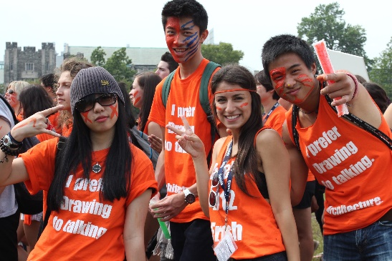

Get Involved
Before you arrive, take the time to think about what else you would like to experience or become involved with while at Daniels.
Daniels Orientation 2024: Registration will begin soon!
Daniels Mentorship Program: Registration Opens (late-summer)
Architecture and Visual Studies Student Union (AVSSU)
Café 059
University of Toronto Student Union
Over 300+ student clubs and organizations!

Slide 24
Questions?
Please join our upcoming live Academic Orientation events to learn more about your upcoming year
Details are available here
Email us at the Office of the Registrar and Student Services: registrar@daniels.utoronto.ca

