Slide 1
Student Experience
2020
Making the Most of your Daniels Experience!
Notes:
Today will be talking about life in the Daniels Community and how you could get involved.

Slide 2
Why get involved?
Learning isn't limited to lectures, libraries and laboratories. Getting involved on campus is one of the best ways to create a sense of belonging at U of T. If you can't find what you're looking for, start something new. Becoming engaged in the student life of the University can be fun and rewarding.
Getting involved at Daniels, within the campus or in the community helps enhance your experience at the university. It is beneficial in many ways, such as:
  Connect with other students with similar interests
  Connect with organizations that interest you on and off campus
  Learn new skills
  Follow a passion
  Create a Co-Curricular Record (CCR)
  Make more friends!
Let us see how you can get started.
Notes:
https://sidneysmithcommons.artsci.utoronto.ca/how-can-i-get-more-involved-on-campus/
http://www.arts.utoronto.ca/get-involved.htm
Handbook

Slide 3
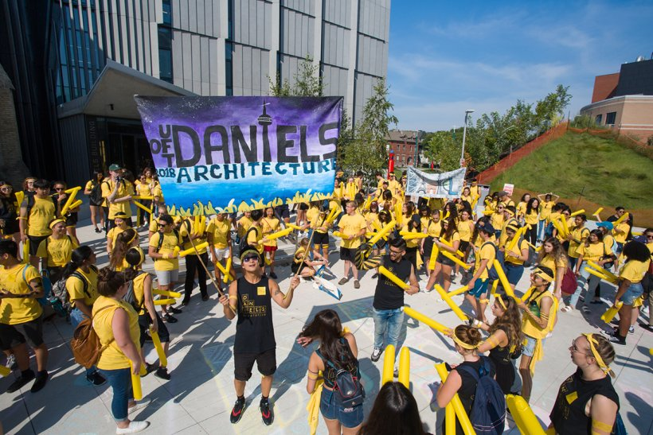
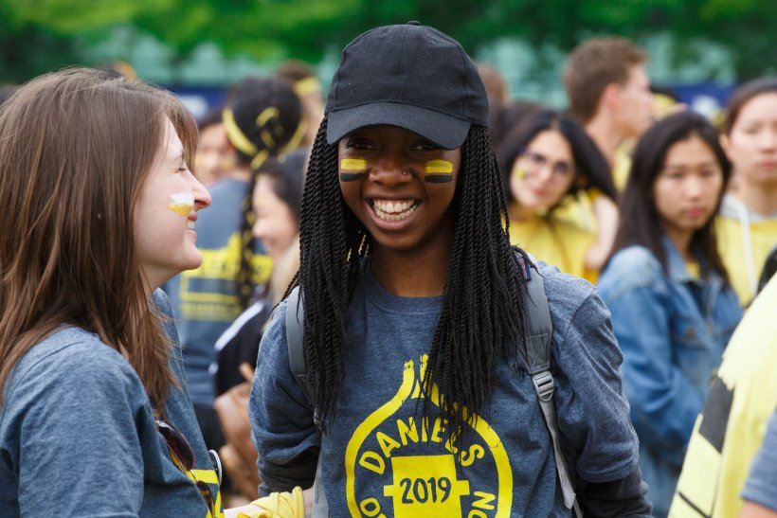
Daniels Orientation 2020
Orientation is full of fun and informative events and activities to help you make a smooth transition to your first year at U of T. Orientation Week is your first opportunity to become involved Daniels student community.
Through virtual events, get acquainted with your peers and the Uof T facilities on fun-filled days to kick off university. Registration information will be available during the summer.
Orientation will help you:
  Connect with campus life
  Learn about opportunities
  Meet your future peers
  Make new friends!
Notes:
https://future.utoronto.ca/newly-admitted-students/orientation/
https://studentlife.utoronto.ca/service/orientation-calendar/
Handbook

Slide 4
Your student experience is about more than your academic experience.

Slide 5
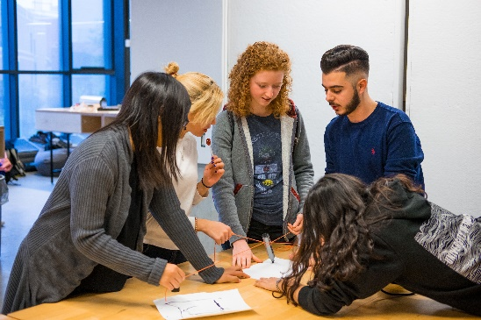
Daniels Mentorship Program
The Daniels Mentorship Program provides first-year students with the opportunity to connect with other first-year students and upper- year students to develop friendships and to learn about resources, opportunities, and life at the Daniels Faculty and University of Toronto.
Mentorship program will appear on your co-curricular record. If you have any questions please contact registrar@daniels.utoronto.ca.
Notes:
Handbook

Slide 6
Architecture and Visual Studies Student Union
AVSSU
The Architecture and Visual Studies Students Union (AVSSU) is a democratically elected student government. AVSSU represents and advocates for the rights of the undergraduate student body at the John H. Daniels Faculty of Architecture, Landscape, and Design at the University of Toronto.
Explore past events and what AVSSU is up to by visiting: http://www.avssu.ca/.
You can also contact AVSSU at avssu@daniels.utoronto.ca.
Notes:
Handbook

Slide 7

SHIFT
SHIFT is a student publication that seeks to promote the interdisciplinary nature of the undergraduate programs in visual and architectural studies at the University of Toronto. It is a dedicated space for discussions about art and design in Toronto and beyond.
SHIFT believes in academic exchanges across a broad spectrum of disciplines, from visual arts and photography to urban studies and geography. For information about how to get involved please visit: https://www.shiftmag.ca/
Notes:
Handbook
Shiftmag.ca

Slide 8
ULIFE
Ulife is a one-stop website listing a large and diverse directory of student clubs, organizations, activities and opportunities on all three campuses. The thousands of entries include film appreciation clubs, debating societies, sports teams, social activism, drop-in classes, and research opportunities and awards.
Students can browse the site or search by keyword and can sort by campus. U of T developed Ulife to help students benefit to the fullest from their university experience including life beyond the classroom. For information about how to get involved please visit: https://ulife.utoronto.ca/
Notes:
https://ulife.utoronto.ca/
https://ulife.utoronto.ca/page/view/slug/about
Handbook

Slide 9
Questions?!
Office of the Registrar & Student Services
Room 100, 1 Spadina Crescent
Toronto, ON
registrar@daniels.utoronto.ca
416-946-3897

