Slide 1

Academic Orientation 2021
John H. Daniels Faculty of Architecture, Landscape, and Design

Slide 2
Welcome to Daniels!
Let’s get ready for your first year at the John H. Daniels Faculty of Architecture, Landscape, and Design.
Andrea McGee
Registrar & Assistant Dean, Students
Carla Baptista
Associate Registrar, Academic Advising & Student Engagement

Slide 3
The Basics.
You are a now a Daniels student pursuing an Honours Bachelor of Arts.
As a Daniels student you will:
Have an amazing team of faculty, staff, and peers ready to support, help, and guide you as you navigate your transition to university.
Enjoy a partnership with the Faculty of Arts & Science and access to over 300+ programs of study!
Occupy three Daniels buildings on campus
  Daniels Faculty at 1 Spadina Crescent
  North and South Borden Buildings at 563 and 487 Spadina Crescent

Slide 4
1 Spadina Crescent.

Slide 5
Getting Started
The New Undergraduate Student Handbook 2021-22 is your guide to getting ready for your first-year at Daniels. To begin you should read the handbook (cover to cover) and consider doing the following:
  Get your student ID (TCard, UTORid and UTmail+ account)
  Review the Academic Calendar 2021-22 and Timetable on the Daniels website
  Familiarize yourself with all the services and resources available to you.
  Follow us on social media
@uoftdaniels

Slide 6
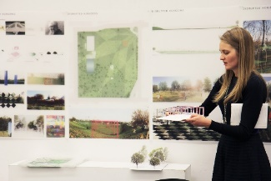
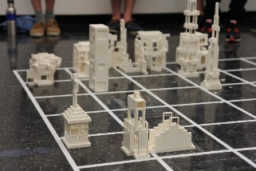
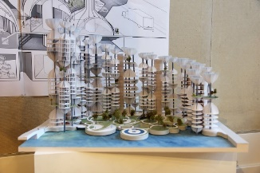
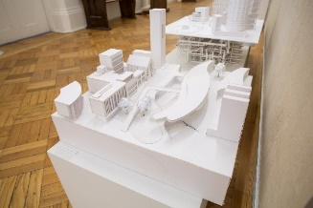


Architectural Studies
Architectural Studies begins with an introduction to the fundamentals of the field through design, history, and technology/computation. This program initiates students into the discipline of architecture, using it as a unique lens through which to pursue a liberal arts education.

Slide 7

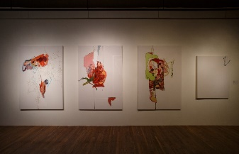
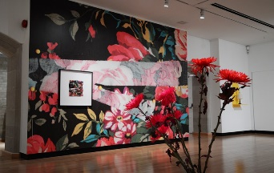


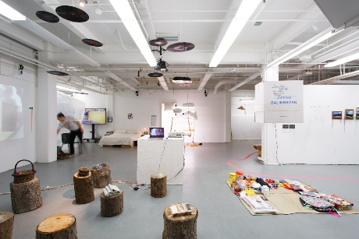
Visual Studies
Visual Studies is set within a unique environment focusing on the interdisciplinary and conceptual components inherent to contemporary art and curatorial practice, as well as on critical writing, theory, art history, design, and related areas requiring a high degree of visual literacy.

Slide 8
Degree Requirements
The Honours Bachelor of Arts degree requirements are found in the Academic Calendar and the New Undergraduate Student Handbook.
To graduate a student must complete:
  20.0 Credits
  Minimum of 13.0 Credits at the 200 level, including
  Minimum of 6.0 Credits at the 300+ level
  1.85 Cumulative Grade Point Average (CGPA) for Graduation
  4.0 Credits satisfying Breadth Requirements
  An appropriate combination of programs of study

Slide 9
Program of Study
Architectural Studies
1 Specialist in Architectural Studies
All students are automatically enrolled in the Comprehensive Specialist stream for their first year of study in the Daniels Faculty.
Students in the Architectural Studies program must pursue one of the four Specialist streams offered:
  Comprehensive;
  Design of Architecture, Landscape, and Urbanism;
  History and Theory of Architecture, Landscape, and Urbanism; or
  Technology of Architecture, Landscape, and Urbanism.

Slide 10
Program of Study
Visual Studies
1 Specialist in Visual Studies (Studio Stream or Critical Practices stream)
OR Major in Visual Studies + Major in Architectural Studies*
OR Major in Visual Studies + 1 Major, Faculty of Arts & Science*
OR Major in Visual Studies + 2 Minors, Faculty of Arts & Science*
*These combinations must include at least 12.0 different Credits.
All Visual Studies students are automatically enrolled in the Major in Visual Studies.

Slide 11
A traditional full course load is 5.0 Credits. Fill your remaining course selections with electives of interest to you.

Slide 12
Course Selection
What courses do I have to take in my first year?
First-year student in the Architectural Studies Comprehensive Specialist Stream, have eight required courses (4.0 Credits):
JAV120H1 F Visual Concepts
JAV151H1 F History of Architecture, Landscape, Urbanism, and Art I
ARC100H1 F Drawing and Representation I
ARC180H1 F Computation and Design
JAV101H1 S Design Studio I
JAV130H1 S Visual Strategies
JAV152H1 S History of Architecture, Landscape, Urbanism, and Art II
ARC181H1 S Technologies of Architecture, Landscape, Urbanism, and Art I

Slide 13
Course Selection
What courses do I have to take in my first year?
First-year student in the Visual Studies Major Stream, you have six required courses (3.0 Credits):
JAV120H1 F Visual Concepts
JAV130H1 F Visual Strategies
JAV151H1 F History of Architecture, Landscape, Urbanism, and Art I
JAV101H1 S Design Studio I
JAV152H1 S History of Architecture, Landscape, Urbanism, and Art II
FAH102H1* This course is offered through the Faculty of Arts & Science.
Note: It is also highly recommended that Visual Studies students enrol in ARC100H1

Slide 14
Course Selection: Electives
What electives should I take in my first year?
You can choose courses at Daniels or courses in over 300 programs of study in the Faculty of Arts and Science.
Things to Consider:
Your interests
Space and availability
Your schedule
Pre-requisites

Slide 15
Reading Course Codes, the Calendar and the Timetable
JAV151H1F
JAV 151 H 1 F
Course codes are divided into a series of parts.
It is important that you look at the Timetable not only to create your class schedule without any course conflicts, but also to ensure that you are eligible to enrol in those courses.
Look for the enrolment indicators on the Timetable.

Slide 16
How do I enrol in my courses?
You will select your courses online using the student online service, ACORN. You will need your JOINid/UTORid and password to log in.
First-year course enrolment begins on July 22. First-year students can find their enrolment start time on ACORN as of July 5.
Transfer students into second year begin course enrolment on July 19. Transfer students into second year can check their start time as of July 5.

Slide 17
Enrolling: Step-by-Step
Start Time
Program Course Requirements
Find an Elective
ACORN Enrollment Cart
ACORN – enrol!
Remember:
Enrollment Indicators/Controls
Priority Period Course Load: 5.0 Credits.

Slide 18
Fees and Finances
General fee information can be found on the Student Accounts website.
Your minimum required payment is indicated on your financial invoice, which is posted on ACORN.
Review the presentation on Fees and Finances, facilitated by Bianca the , Associate Registrar, Awards, & Financial Aid.
Also join us on June 28th for a Finances and Money Matters Live Q&A Session on Zoom!

Slide 19

Student Supports
Watch the other presentations that cover information about resources within the Daniels Faculty as well as the University-wide supports

Slide 20
Accessibility Services
Accessibility Services works with students living with:
  Chronic health conditions, learning disabilities, mental health conditions, mobility or functional disabilities, sensory disabilities, and temporary disabilities & injuries.
Support students by providing:
Access to academic accommodations & services
A network of supportive resources & strategies
Daniels has an On-Location Accessibility Services Advisor, Sandra Hohener

Slide 21
International Student Support
The Centre for International Experience (CIE) provides supports to students on such topics as:
Study or work permits
Finding immigration resources
Cultural challenges, relieving homesickness
Navigating the Canadian health care system
Understanding income taxes
Academic expectations and adjustments

Slide 22
Your student experience is about more than your academic experience.

Slide 23
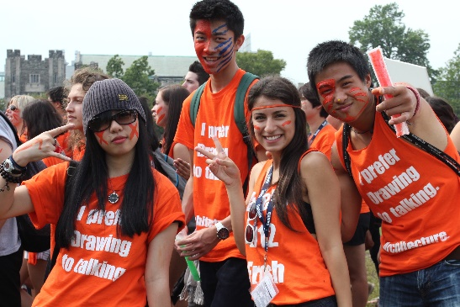

Getting Involved
Before you arrive, take the time to think about what else you would like to experience or become involved with while at Daniels.
Daniels Orientation 2021: Registration will begin soon!
Daniels Mentorship Program: Registration Opens (late-summer)
Architecture and Visual Studies Student Union (AVSSU)
Café 059
University of Toronto Student Union
Over 300+ student clubs and organizations!

Slide 24
Questions?!
After reviewing the New Student Handbook and presentations, you can join our Zoom Events and meet the Program Directors, Staff and Students for a Welcome Q&A sessions.
You are also welcome to email us at the Office of the Registrar and Student Services at registrar@daniels.utoronto.ca

