Slide 1
Financial Fundamentals.
This is the first of two Financial Fundamentals slide shows. It will discuss -
Fees and Payments
Tuition Fees
Deadlines
Making Payments
Fee Deferral
The second Financial Fundamentals slide show will discuss -
Financial Planning and Support
Costs of University
Things to Consider
Sources of Funding
Counselling
https://clipartion.com/free-clipart-13909/
Notes:
Welcome to the Daniels Faculty! We’ve prepared two slide shows for all of you to help you with managing your finances while you are here at Daniels. This first slide show will provide you with a basic overview of fees and payments including important dates and deadlines. The second slide show will detail the different financial resources that are available to you.
If you have any questions after viewing these two slide shows, feel free to contact us. Our contact information is noted at the end of both slide shows. Let’s begin.!

Slide 2
Fees and Payments.

Slide 3
Tuition Fees
=
Course/Program Fees
+
Incidental,
System Access &
Ancillary Fees
Notes:
First up, a brief explanation of your tuition fees, or what you will need to pay to the University and the Daniels Faculty for your studies.
Your tuition fees are made up of two separate things;
First are the fees you pay for the courses you are in – these are your program or course fees.
Second are the incidental, system access, and ancillary fees, which pay for university services like health and wellness, student counselling, career services, and athletics and recreation.

Slide 4
PLUS
Residence Fees
For students living in residence
Notes:
For those who are living in residence (for example New College next door to Daniels, or Chestnut Residence south of Daniels), you will also be paying your residence fees to the University.

Slide 5
New Undergraduate Student Orientation: Financial Fundamentals
Course/Program Fees.
Initially, all students will be charged the program fees above. Those who enroll in 3.5 credits or less over fall and winter terms may qualify for per-course fees, based on meeting deadline dates.
See the Fees page on the Daniels website for more information about program fees vs course fees.
Actual Program Fees 2020-21 - 5 credits total over fall and winter terms = 100% course load-
- domestic | $6,100
- international | $57,020
Notes:
On this slide, you will see the fees that you will be assessed for the courses that you are enrolled in or are taking.
If you’re taking 4.0 credits or more over both fall and winter terms, you will be assessed these flat program fees.
Everybody will be assessed these program fees at the beginning of each year. And if you’re taking 3.5 credits or less over both fall and winter terms, you may be eligible to request to be assessed course fees, where you pay per course.
More information about the process for requesting per-course fees assessment can be found on the Daniels website cited here.

Slide 6
New Undergraduate Student Orientation: Financial Fundamentals
Course/Program Fees.
Questions about fee refunds and adding/dropping courses?
RECOMMENDATION: Talk to us in the Office of the Registrar and Student Services before taking action.
Fee and refund schedules Student Accounts website (all important fee deadlines are listed here as of mid-July):
Office of the Registrar and Student Services (for general advising):
https://www.daniels.utoronto.ca/resources/student-services
Notes:
We always recommend that you discuss your questions about adding or dropping courses with us here at the Office of the Registrar and Student Services or ORSS. You can always email us at registrar@daniels.utoronto.ca. We’ll note our email addresses again at the end of this slide show.

Slide 7
New Undergraduate Student Orientation: Financial Fundamentals
Incidental & Ancillary Fees.
For
course/program materials and activities
student society fees (AVSSU and UTSU)
university operated services – health and counselling, academic support services, athletics and recreation (online programs are being offered this fall)
Estimated Incidental/Ancillary Fees | $1,500
Estimated UHIP for basic insurance plan (for international students) | $624
Notes:
In addition to your program or course fees, there are services available at Daniels and the University that you will be assessed or asked to pay as well.
These are called incidental or ancillary fees, and the estimated amounts for this year are noted on this slide. You will see all of these fees detailed on your fees invoice on your ACORN account, so you will know exactly which services you have been assessed. I always encourage students to review all these fees on their invoice, so that they can see what are the services they are paying for.
And I always encourage students to make use of these services, since they are already paying for it!
This fall, while courses are all online, services such as athletics and recreation that students would normally go to when they are on campus have online offerings. I encourage you to use these services from the comfort of your own home!

Slide 8
New Undergraduate Student Orientation: Financial Fundamentals
Incidental & Ancillary Fees.
Some fees may be refunded upon request:
Student Health and Dental plan opt-out (with proof of alternate coverage – for example, coverage under parents’ private insurance) http://studentcare.ca/rte/en/IHaveAPlan_UTSU_ChangeofCoverage_OptOuts
You must pay all tuition fees even if you are opting out of your health and dental plan. After your opt out is completed, and after the end of the Change-of-Coverage Period, a cheque for the amount of the Plan will be mailed to you.
If you have questions about your coverage, contact your student union.
University of Toronto Students’ Union
https://www.utsu.ca/
Association of Part-Time Undergraduate Students
https://apus.ca/
Notes:
There are some incidental fees that students can request to be refunded back to them.
For example, if you are still covered under your parents’ health insurance plan, it makes sense to not have double coverage from the health and dental plan offered by your student union. You will need to show proof of alternate coverage. The StudentCare website listed on this slide is where you can get all the information on what you need to do to show proof of your health insurance coverage.

Slide 9
New Undergraduate Student Orientation: Financial Fundamentals
The Deadline.
Wed, Sept 2, 2020
Last day to either
Pay indicated minimum payment to register amount on ACORN fees invoice.
Request a fee deferral on ACORN.
If you do not make the minimum payment or defer your fees, you will be “financially cancelled” and removed from courses.
See the Fees page on the Daniels website for more information about how to pay your minimum payment to register, or how to request a tuition fee deferral.
Notes:
By mid-July, you can view your 2020-21 fees on the fees invoice on your ACORN account. You are responsible for monitoring your fees invoice. No paper copies will be mailed to you, but you can always print out your fees invoice if you need a paper copy.
Please keep this deadline date in mind – Wed, Sept 2. This is the last date to get yourself registered. You get registered by either paying the minimum payment to register amount listed at the bottom of your ACORN fees invoice, or by successfully requesting a tuition fee deferral.
Click on the Fees page link on this slide to view the Tuition Fee Payments and Deferrals PDF on the Fees page on the Daniels website. That PDF includes all the details for paying your fees, or for requesting a tuition fee deferral. The next few slides will talk about these two processes.

Slide 10
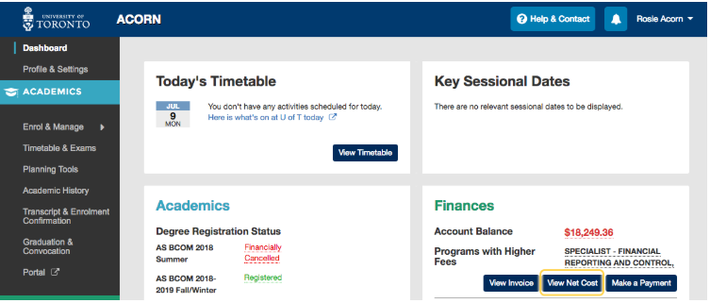
Fees and Payments.
Log in to your ACORN account to view and print invoices from your Financial Account on ACORN www.acorn.utoronto.ca. Invoices are not mailed.
ACORN is U of T’s student information service, and a hub for everything you need to manage your student life. Under the Financial Account section, your tuition fee invoice will be posted. The invoice will break down all tuition charges by line item.
Sample Fees Invoice
Notes:
Here’s a screenshot of the ACORN dashboard, in case you have not yet logged in to your ACORN account.
Where the Account Balance is red – that’s what you still need to pay to the University. Keep in mind, you are not required to pay all of that red amount in one payment by the Aug 26 payment deadline. So it’s best to view your fees invoice to check what you are required to pay by Aug 26.
Click on the View Invoice button to see your fees invoice.
Click on the Make a Payment button to see how you can pay your fees.
Once your payment has reached your ACORN account, the red amount will change or go down. On the Academics section of your dashboard, it will also show that you are registered in your program for the 2020-2021 Fall/Winter.
There’s a link to a sample fee invoice on this slide. Click on it and you’ll see an annotated fees invoice pop up on your browser.

Slide 11
New Undergraduate Student Orientation: Financial Fundamentals
Payments.
To become registered for the 2020-21 academic year, first option is to pay your tuition fees.
Pay via
your Canadian bank (online, telephone, or in-person)
a credit card - subject to a 1.75% convenience fee
WU Global Pay – if paying from outside Canada
NO payments in person to Student Accounts or Daniels.
How to make a fee payment:
https://studentaccount.utoronto.ca/
(then click on the Make a Payment link)
Notes:
The Make a Payment button on your ACORN dashboard will explain your options for paying so that you can get registered – you can pay from your Canadian bank, or use a Canadian credit card. Keep in mind that if you use a credit card, you will be assessed a convenience fee, which means more money out of your credit card.
If you’re paying from outside Canada, your best option is to pay through Western Union Global Pay.
To review all the details for how to make a payment, click on the Student Accounts link on this slide. It will provide you the same information as you will see when you click on the Make a Payment button on your ACORN dashboard.

Slide 12
New Undergraduate Student Orientation: Financial Fundamentals
Payments.
Paying your fees:
ROSI account number on top right hand corner of ACORN fees invoice
Use this as your account number on your payment
Without this number, your payment will not be credited to your ACORN account
Pay the minimum payment to register listed at the bottom of your ACORN fees invoice.
Minimum payment to register = fall term tuition fees
Keep proof of payment.
Notes:
When paying your fees, whether via your Canadian bank or your Canadian credit card or WU Global Pay, use your ROSI account number as the account number on your payment. You can find your ROSI account number at the top right-hand corner of your ACORN fees invoice.
If you do not include your ROSI account number, your bank or your credit card or Western Union will not know where to direct the payment you are making. Remember the University is big, and there are more than 93,000 students here, which means there are 93,000 ACORN accounts to direct payments to.
When paying by the August 26 payment deadline, pay the Minimum payment to register amount at the bottom of your fees invoice. This minimum payment to register amount is equivalent to your fall term fees. You are not required to pay both your fall term and winter term fees by this deadline date, just your fall term fees. You will be able to pay your winter term fees at a later deadline date.
And always keep a copy of your payment, so that in case you need to follow up about it, you have that proof handy.

Slide 13
New Undergraduate Student Orientation: Financial Fundamentals
Payments.
Paying your fees:
Takes between 3 and 5 business days for your payment to be reflected on your ACORN account.
Monitor your ACORN account for your payment.
Once payment is credited, your ACORN dashboard will show
Change from Invited to Registered
A lower account balance
If payment does not appear on ACORN after 5 or 7 seven business days,
Email us your proof of payment (registrar@daniels.utoronto.ca)
Notes:
Once you have made your payment, monitor your ACORN fees invoice. Your payment will be reflected there in three to five business days after you made the payment. For Western Union Global Pay, it might take as much as five to seven business days.
Once you see the payment on your ACORN, your ACORN dashboard will also change from INVITED to REGISTERED. That means you’re now registered in your program for the 2020-21 academic year.
You will also see the amount in red, your account balance, will have gone down. Remember that you will still need to pay that red amount at a later date.
If your payment still has not shown up on your ACORN fees invoice after five or seven business days, email us your proof of payment and we will help you track it down.

Slide 14
New Undergraduate Student Orientation: Financial Fundamentals
Payments.
Paying your fees:
SERVICE CHARGES: Monthly service charge of 1.5% compounded (19.56% per annum)
After you have paid your fall term fees,
Winter term fees are due Nov 30
Unpaid/outstanding winter fees as of Dec 1 will be assessed service charges in mid-Dec.
You can pay by instalment.,
For example to pay fall term fees = minimum payment to register Pay in instalments between mid-July and Aug 26 payment deadline.
To pay winter term fees, pay in instalments between Aug 26 and winter term fee payment deadline of Nov 30.
Notes:
It is possible to pay by instalment – for example, to pay your fall term fees, pay in instalments between mid-July and the payment deadline on Aug 26. To pay your winter term fees, pay in instalments between Aug 26 and the winter term fee payment deadline of Nov 30.
Service charges are assessed on any outstanding fees, based on the schedule listed on this slide.
So try as best as you can to pay your fees by the listed payment deadline dates.

Slide 15
New Undergraduate Student Orientation: Financial Fundamentals
Deferrals.
To become registered, for the 2020-21 academic year, the second option is to request a tuition fee deferral.
A successful fee deferral
Allows eligible students to officially register for their studies without having to make a minimum payment by August 26.
Defers/extends payment deadlines
Fall term – from Sept 2 to Sept 30
Winter term – from Nov 30 to Jan 31
Who’s eligible? Students who are receiving
OSAP loans and grants
out-of-province loans and grants
US Direct Loans
scholarship funding greater than the minimum payment to register amount
These students are eligible for a fee deferral because their funds will not be available until after classes start in September.
Notes:
The other option to become registered for the 2020-21 academic year is to request a tuition fee deferral.
If you are successful in requesting a tuition fee deferral, you will get registered into your program even if you have not yet paid any portion of your fees. Your fee payment deadline is also deferred or extended to a later date. Your fall term fee payment deadline will get extended from Sept 2 to Sept 30, and your winter term fee payment deadline will get extended from Nov 30 to Jan 31.
Students who have applied to and are receiving government student loans and grants, or are receiving scholarship amounts that are greater than or equal to the minimum payment to register amount listed on their ACORN fees invoice are eligible to apply for a tuition fee deferral. These students are eligible bec they have money coming from their government loans and grants, or from their scholarship, but their money is not yet available by the Aug 26 payment deadline.

Slide 16
New Undergraduate Student Orientation: Financial Fundamentals
Deferrals.
OSAP Loans and Grants
You must have already applied for OSAP. Wait three business days after you submit your OSAP app before applying for a tuition fee deferral.
Out-of-Province Loans and Grants
Submit a copy of your proof of 2020-21 application or funding notice to Enrolment Services (can.oop.financialaid@utoronto.ca) with your student number written on it. Wait three business days after submission before applying for a tuition fee deferral.
US Direct Loans
You must have completed all application steps (FAFSA + UT steps). Wait three business days after you email your UT US Loans application to usa.financialaid@utoronto.ca before applying for a tuition fee deferral.
Notes:
Students with government student loans and grants for 2020-21 are eligible to request tuition fee deferrals. There are different steps to follow, depending on what type of government student funding you have applied for.
Here is a tip – do not wait until the last minute to apply for your government student funding. Apply as soon as possible, so that you can apply for a tuition fee deferral as soon as possible, so that you get registered as soon as possible.

Slide 17
New Undergraduate Student Orientation: Financial Fundamentals
Deferrals.
Government student loans and grants – Three days after you submit your application, click on the Tuition Fee Deferral button in the Finances section of your ACORN account starting in mid-July.
After following the steps, you will immediately see if your fee deferral request is successful or not.
If there is a problem, email us at awards@daniels.utoronto.ca or registrar@daniels.utoronto.ca.
Remember: You are still responsible for paying your fees after a successful tuition fee deferral.
Pay your tuition fees
As soon as you receive your funding.
FT-OSAP funding will automatically pay towards your tuition fees first.
By Sept 30 (for fall term fees).
By Jan 31 (for winter term fees).
Notes:
For students with government student funding – wait three days after you submit your application before you click on the Tuition Fee Deferral button on your ACORN account.
If you are successful with your deferral request, you will immediately see.
If it notes that there is a problem, email us, and we will look into why there is a problem.
Remember, your successful tuition deferral registered you without any payments, but you still need to pay your fees by your extended payment deadlines of Sept 30 for fall term fees and Jan 31 for winter term fees.

Slide 18
New Undergraduate Student Orientation: Financial Fundamentals
Deferrals.
Scholarships
You may apply for a fee deferral if you are receiving a scholarship for 2020-21 that is equal to or greater than your required minimum payment. Email us at awards@daniels.utoronto.ca with proof of your scholarship.
You will be advised if your tuition deferral request is approved or not.
Work with your scholarship funding agency to ensure that your scholarship amount is paid to your ACORN account by the Sept 30 fall term fee payment deadline.
If your scholarship amount is lower than your minimum payment to register amount, pay the difference between your scholarship amount and the minimum required amount by the Aug 26 payment deadline.
Notes:
Students who have scholarships that are equal to or greater than the required minimum payment listed on their fee invoice are also eligible to apply for a tuition fee deferral.
Email us proof of your scholarship. Once we have processed your tuition fee deferral, we will notify you.
If your scholarship provider is not Daniels or UT, work with them to ensure that your scholarship money is paid to your ACORN account by the Sept 30 fall payment deadline.
If your scholarship amount is lower than the required minimum payment listed at the bottom of your fees invoice, pay the difference between your scholarship amount and your required minimum payment. For example, if your required minimum payment is $4000 but your UT admissions scholarship is only $1000,, pay $3000 towards your ACORN account from your own resources. Your payment will get you registered.

Slide 19
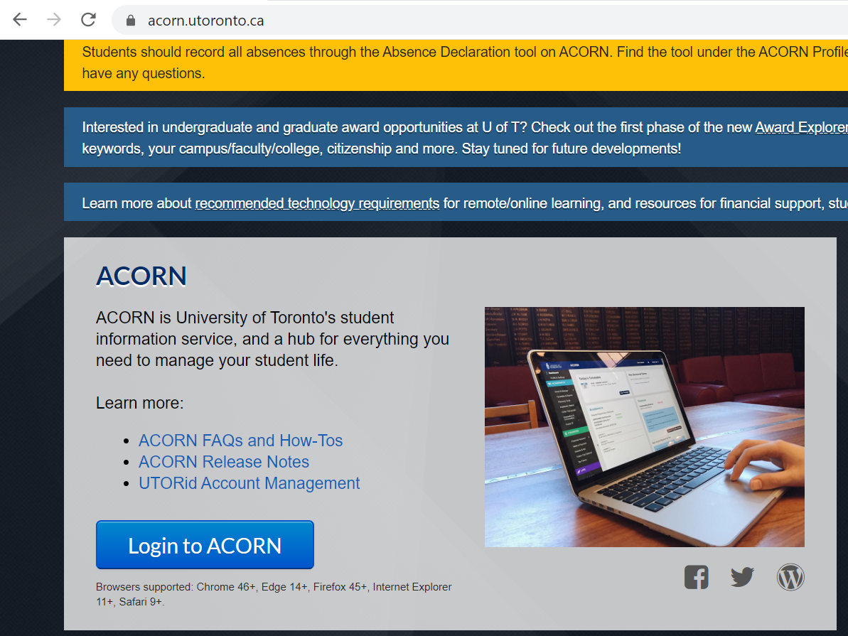
New Undergraduate Student Orientation: Financial Fundamentals
ACORN FAQs and How-tos
Notes:
On your ACORN, click on the ACORN FAQs and How-Tos, as it gives you great information (including videos) on how to make your fees payment, and request a fee deferral.

Slide 20
Financial literacy
is essential
to your overall success.
https://www.canada.ca/en/financial-consumer-agency/services/financial-basics/financial-basics-videos.html
Notes:
As you are about to start your university adventure, we encourage you to review the Financial Basics videos on this Government of Canada website. You will gain a lot of insight into how to manage your money, so that you can be successful not just at university, but later on after you graduate.

Slide 21
Questions?!
Office of the Registrar & Student Services
Room 100, 1 Spadina Crescent
Toronto, ON
awards@daniels.utoronto.ca or registrar@daniels.utoronto.ca
Notes:
If you have questions after viewing this slide show, please contact us either at awards@daniels.utoronto.ca or at registrar@daniels.utoronto.ca.
We’ll see you in the next slide show on Financial Resources!

